Slide 1
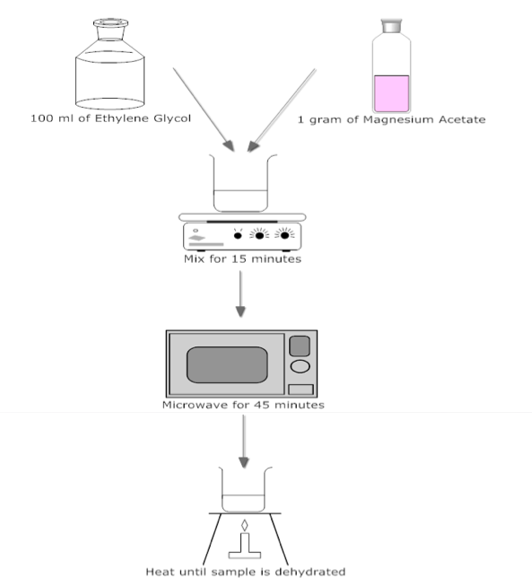
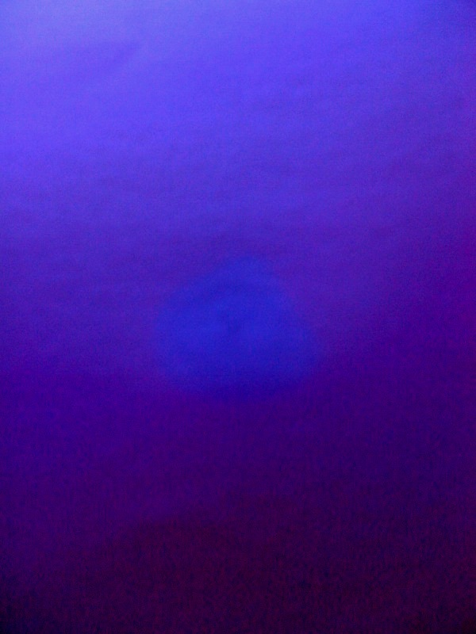
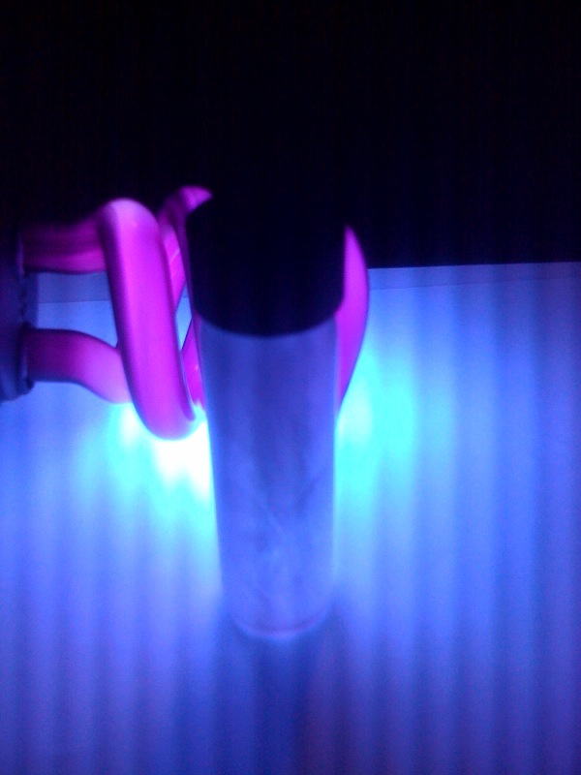
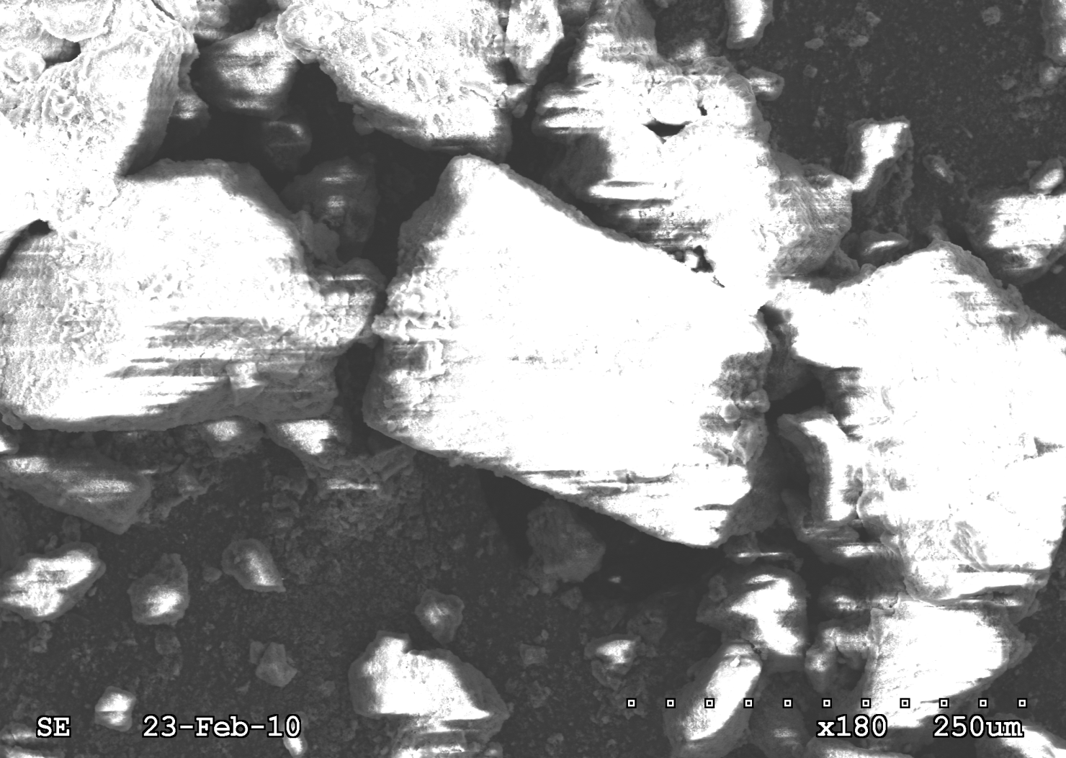
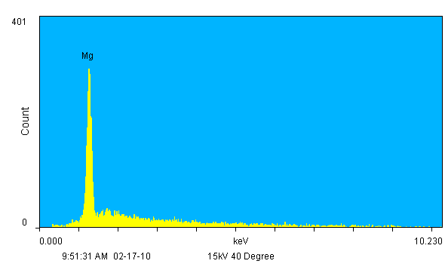
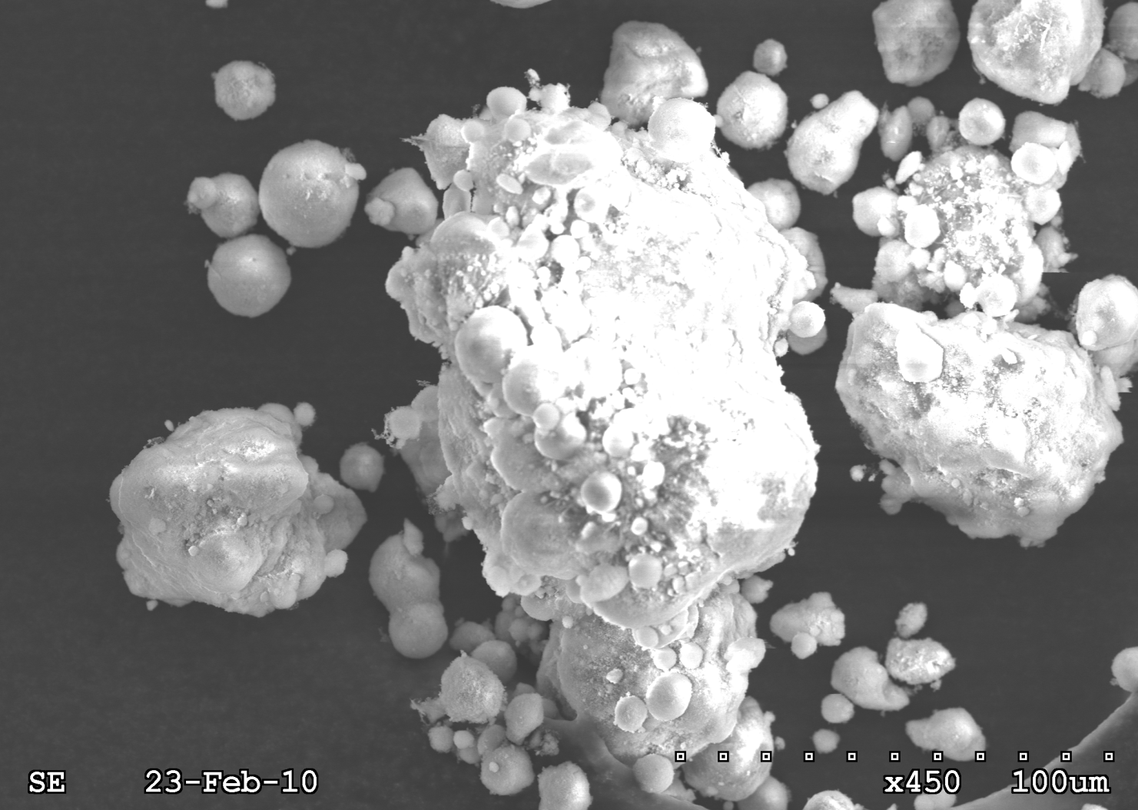
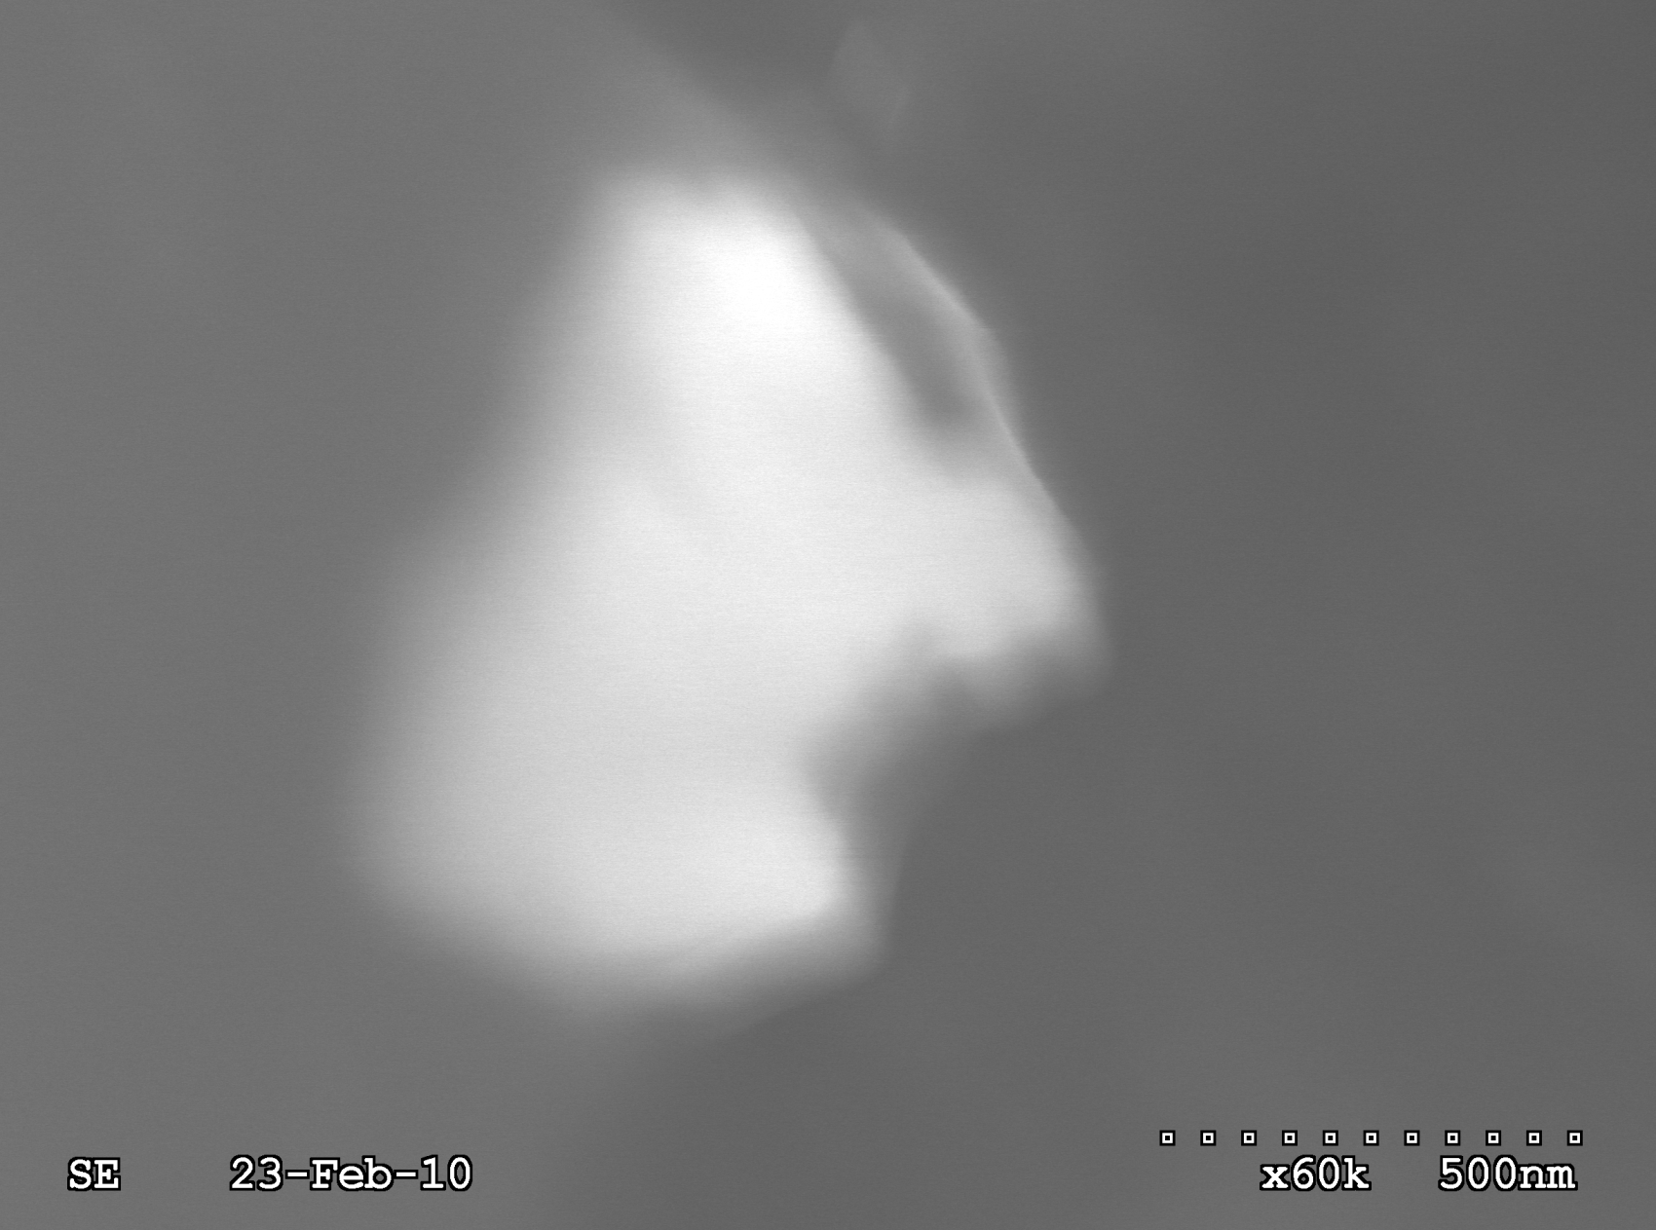
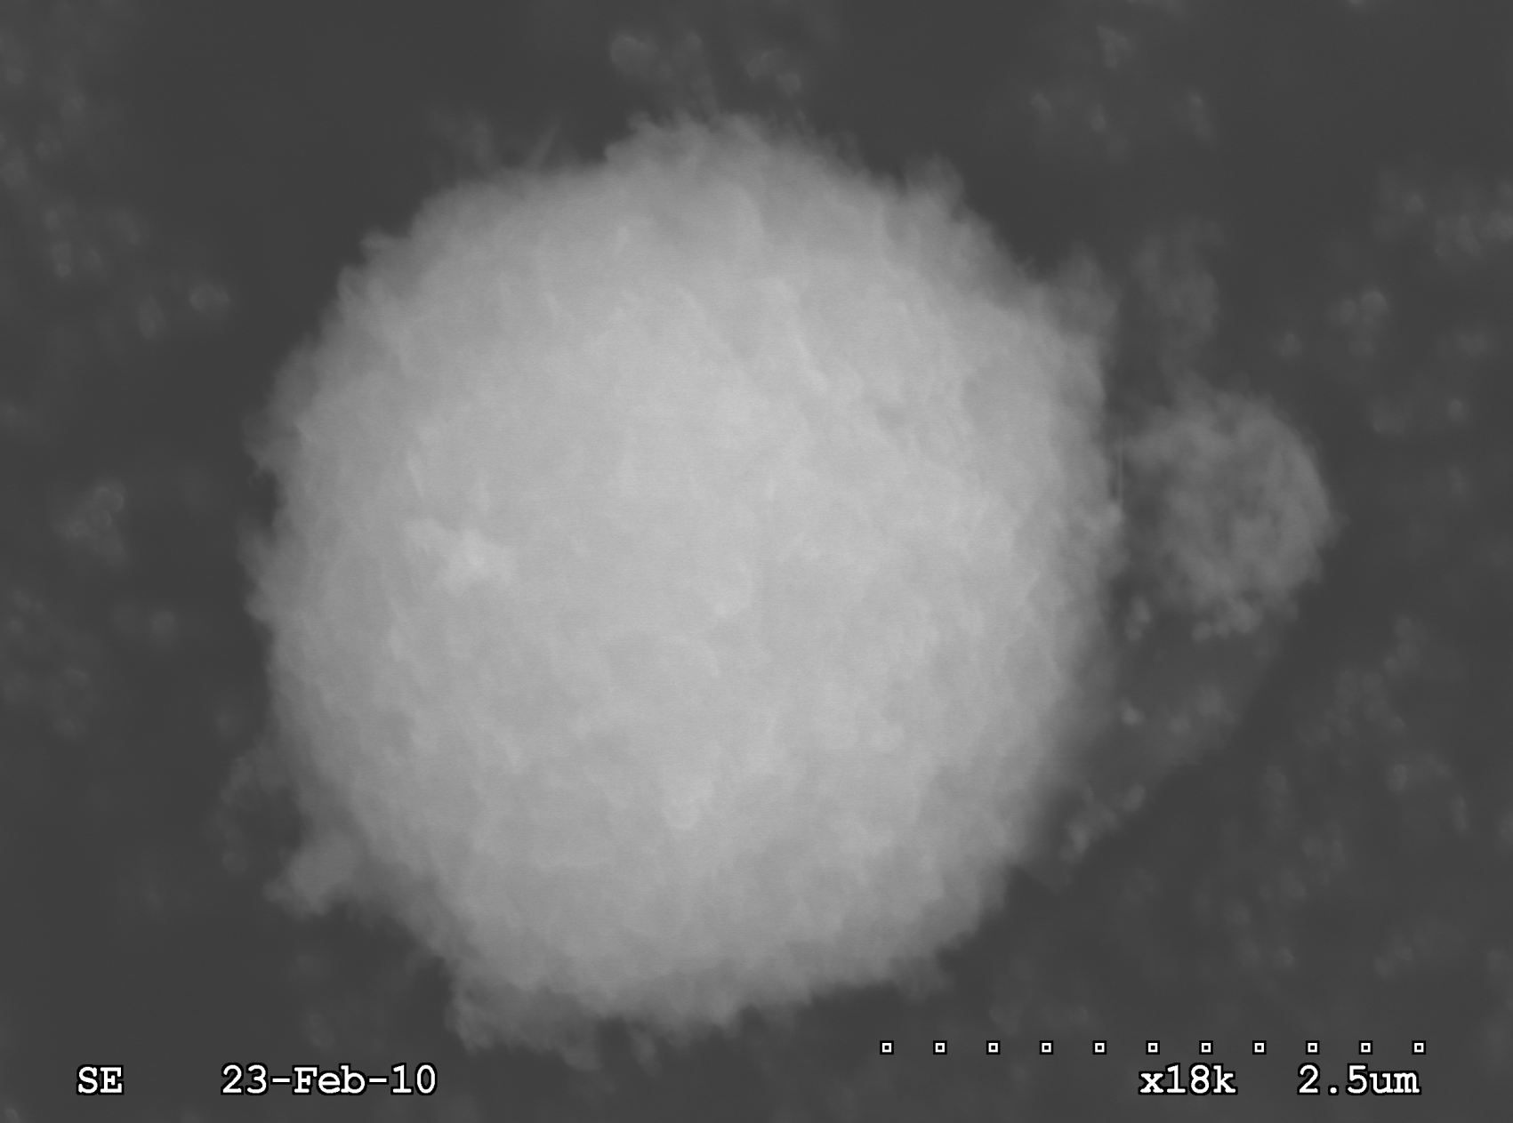
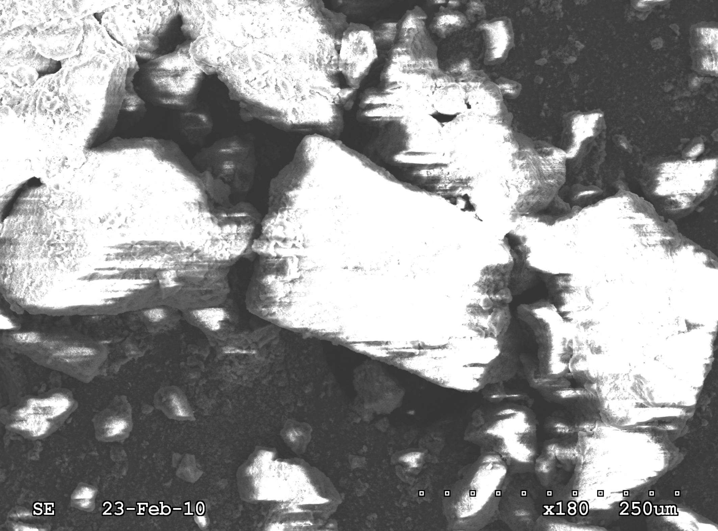
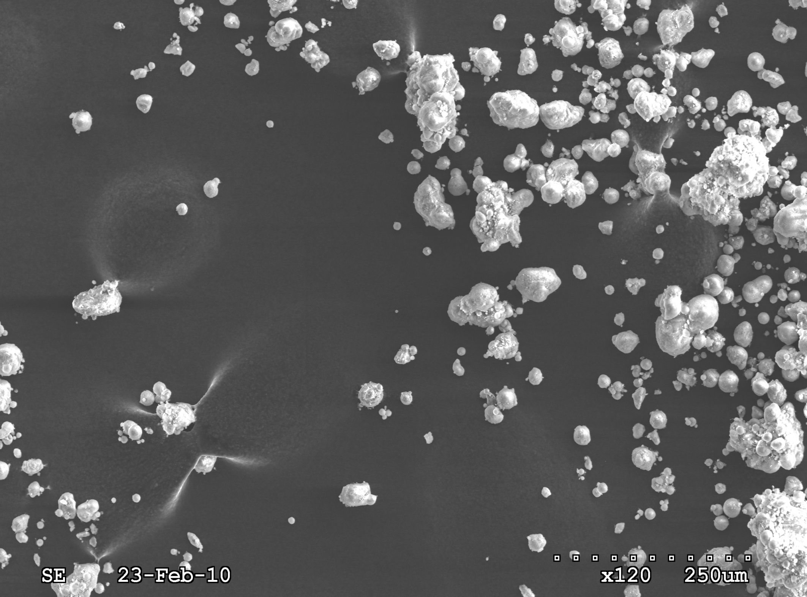
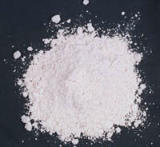
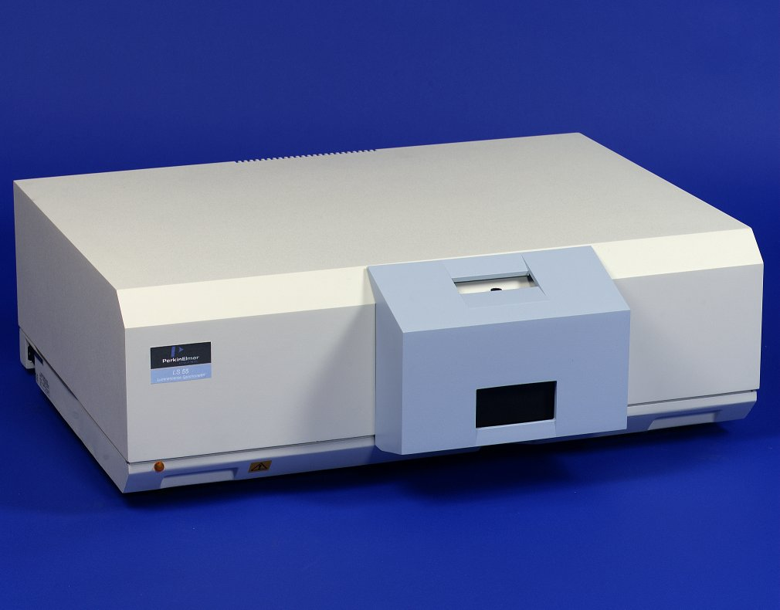
Synthesis of Magnesium Oxide Nanocrystals for Use in Solid State Lighting
Background
Unlike inefficient filament based electric bulbs that create a large amount of excess heat or fluorescent light bulbs that also generate excess heat, solid state lighting is energy efficient. Solid state lighting is referred to as lighting that originates from the electroluminescence of various substances. Solid state lights are an attractive form of lighting as they are small, very resistant, use little electricity, and have a very long lifespan. However, one of the main problems of solid state lighting has been that it is difficult and expensive to create white light. In most solid state lighting devices, white color is achieved by combining red, green, and blue light. Creating red and green light is simple, but creating a bright blue light through electroluminescence is a complex and costly process. However, research has suggested that magnesium oxide nanocrystals are photoluminescent. These nanocrystals emit an intense blue light when they are excited by ultraviolet radiation. Therefore, MgO nanocrystals may be useful in solid state lighting to create the desired bright blue light. To date, adaptation of MgO nanocrystals as a lighting source has been impeded by the expensive process needed to create the material (i.e. chemical vapor deposition). Therefore a novel method of using microwave radiation to create MgO nanocrystals is desirable.
Results
My research indicates that magnesium oxide nanocrystals can be synthesized in a simple, and less expensive method, relative to current means of synthesis (chemical vapor deposition). In this research, magnesium oxide nanocrystals can be formed by dehydrating the magnesium hydroxide nanocrystals created by exposing an ethylene glycol and sodium acetate solution to microwave radiation using a simple microwave oven. The successful creation of luminescent MgO nanocrystals was first confirmed by surface fluorescence spectroscopy. Luminescent measurement of the crystals created form this novel approach exhibited a strong fluorescent emission at 406 nm, with a maximum emission at 337 nm. A similar luminescent analysis of the magnesium acetate and ethylene glycol starting materials verified that the compounds did not fluoresce, and that a new entity had been created. This data was supported with images of the MgO nanocrystals using scanning electron microscopy (SEM) and energy dispersive spectroscopy (EDS). Although the resolution on the SEM was too low to gather images of individual nanocrystals, a scan at x60k magnification reveals the presence of nanocrystal conglomerates (figure 8b). At x180 magnification, it is evident that these nanocrystal conglomerates have a crystalline shape (figure 7). SEM scans of MgO powder did not exhibit such properties. Scans of the MgO powder at x450 magnification reveal a conglomerate of spherically shaped particles (figure 10) instead of crystalline shapes. One of the smallest particles of the powder was found to be several microns in size (figure 11b). To support the presence of Mg in the nanocrystals examined by SEM, an energy dispersive spectroscopy (EDS) spectrum of the same crystal that is shown in figure 8b confirms the presence of magnesium. These differences between commercial MgO powder and the new nanocrystalline solid provide strong evidence that MgO nanocrystals were synthesized.
This new method of efficiently, and easily synthesizing magnesium oxide nanocrystals has far reaching applications. These nanocrystals may be useful as solid-state lighting, and may be adaptable to increase the efficiency and resolution of TV and computer displays.
Front Surface Luminescence Spectra of Synthesized MgO Nanocrystals
Excitation spectrum with a 406 nm emission wavelength
Emission spectrum with a 337 nm excitation wavelength
Figure 3: Procedure Diagram
Figure 4: Front Surface Excitation and Emission Spectra of MgO nanocrystals. Data collected by the student researcher at his school using a PerkinElmer LS50B luminescence spectrometer. Scan speed = 500 nm/min, Excitation/Emission slits = 5 & 5 nm, respectively.
Purpose
Conventional methods of creating magnesium oxide nanocrystals for solid state lighting are difficult, and energy inefficient. This project focuses on finding a simple, and low cost method to create these blue light emitting nanocrystals.
Fluorescence Images
Fluorometer Results
The excitation and emission spectra above confirm literature, which suggests that Magnesium Oxide emit a bright blue light when exposed to ultraviolet (UV) radiation. The fluorescent emission spectrum (red curve) reveals a maximum emission wavelength of 406 nm (blue light) for the MgO nanocrystals when exposed to an excitation wavelength of 337 nm. Conversely, the excitation spectrum of the MgO nanocrystals (green curve) indicate that the maximum (or optimal) excitation wavelength for the MgO nanocrystals is 337 nm.
Hypothesis
Research will reveal that magnesium oxide nanocrystals photoluminesce, producing a bright blue emission. These nanocrystals will be created in a single step process that is both simple, and energy efficient.
Figure 5: Fluorescence of a drop of MgO nanocrystal suspension in ethanol on a white substrate
Figure 6: Fluorescence of a MgO nanocrystal coated glass vial
Procedure
100 mls of Ethylene Glycol (EG) was mixed with one gram of magnesium acetate
The solution was stirred in a volumetric flask for about twenty minutes until the magnesium acetate had dissolved
The solution was poured into a beaker and later placed in a household microwave for thirty minutes, creating Mg(OH)₂
The Mg(OH)₂ in excess EG was then placed in a test tube and was heated with a Bunsen burner until the sample turned to powder, indicating that the Mg(OH)₂ had dehydrated into MgO
A suspension of MgO in ethanol was created to analyze the photoluminescence of the suspension in a fluorometer
Scanning Electron Microscopy
Conclusions
A novel method has been established to simply and easily create magnesium oxide nanocrystals from magnesium acetate, and ethylene glycol, using microwave irradiation.
These MgO nanocrystals were found to exhibit a blue-light emission at 406 nm, with a maximum excitation wavelength of 337 nm.
These results support my original hypothesis.
Figure 7: Image of MgO nanocrystals at x180 magnification
Figure 9: EDS Spectrum of MgO nanocrystals
Figure 10: Image of MgO powder at x450 magnification
Future Work
Future work would consist of making the magnesium oxide particles electroluminesce.
Once electroluminescence of Magnesium Oxide nanocrystals is achieved, a system to use MgO nanocrystals in solid state lighting will be implemented.
(b)
Figure 8a: Image of MgO nanocrystals at x180 magnification
Figure 8b: Zoom of MgO nanocrystal at x60k magnification
(b)
Figure 11a: Image of MgO powder at x180 magnification
Figure 11b: Zoom of MgO powder particle at x18k magnification
Figure 1: Magnesium Oxide Nanocrystal powder
Figure 2: Perkin Elmer LS50B Luminescence Spectrometer used in this research
(a)
(a)

